Slide 1

x
x
Group D
Project Churn
x
Renu Patel | Chirath LV | Aelrid Crasta | Eli Muse
x
Notes:
Add note to this slide

Slide 2

Project Description
This project has developed a web
based application that facilitates the processing of new customer data into a
pre-determined machine learning model to derive the churn - retain value for the customer.
x
x
Notes:
Add note to this slide

Slide 3





x
Assumptions
x
Data
Data provided reflects historical data.
Accuracy
x
Historical data is correct.
Model
Model selected correctly predicts at risk customers.
x
Notes:
Add note to this slide

Slide 4




x
x
Methodology
Identify dataset
Data cleaning and preparation
Analyze & predict
Build a front end interface
Notes:
Add note to this slide

Slide 5
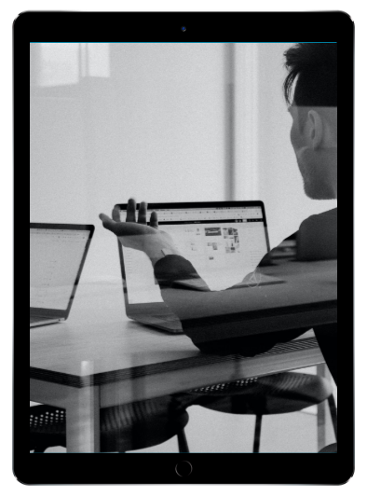
App Features
User interface
x
User friendly front end.
Upload feature
Allows user to upload churn data for analysis
Dashboard with filtering
x
Extracts meaningful insights from uploaded data.
Notes:
Add note to this slide

Slide 6
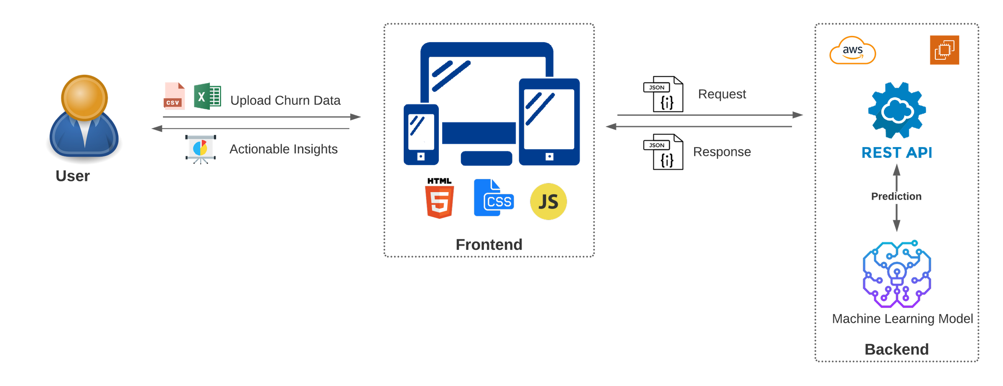
x
x
App Architecture
Notes:
Add note to this slide

Slide 7
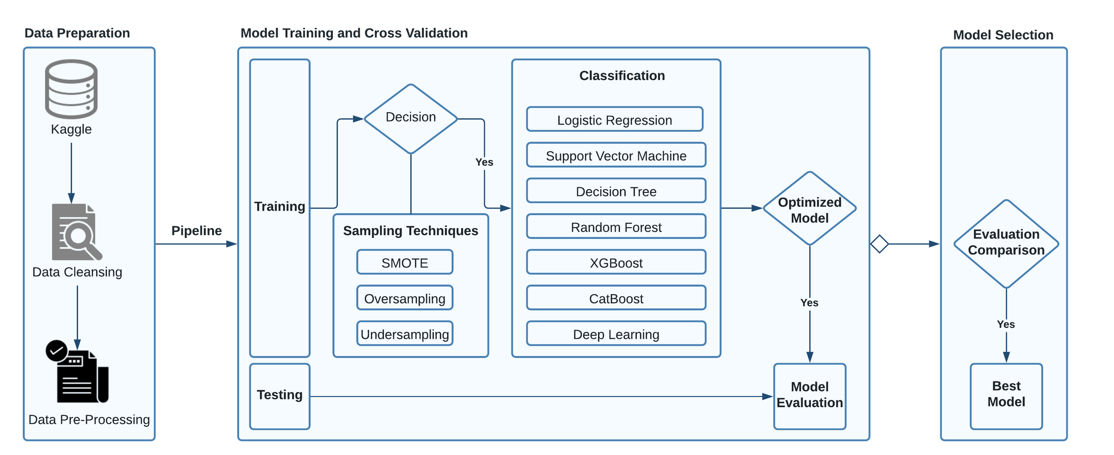
x
Process
ML Process
x
x
x
Notes:
Add note to this slide

Slide 8
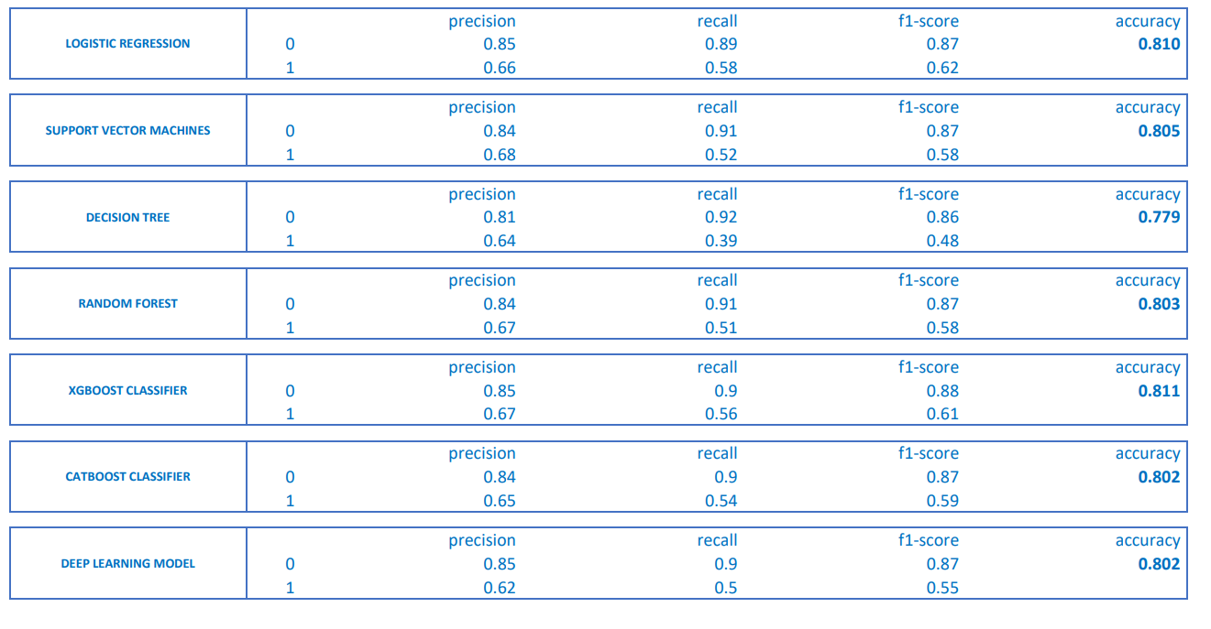
Model Output Summary

Slide 9






Model Performance
Based on Accuracy Score
81.1%
81.0%
80.5%
XGBoost
Logistic Regression
Support Vector Machine
x
x
Notes:
Add note to this slide

Slide 10




Findings
1
2
Feature Importance
Model selection
Tenure, monthly charges and number of dependents were top indicators of cancellation risk.
XGBoost at 81% accuracy outperformed other models.
Optimisation
3
4
Deployment
Hyper-parameter tuning increased model performance.
For cross platform compatibility a RESTful API was created for
deployment in AWS.
x
x
Notes:
Add note to this slide

Slide 11






Future Development
High availability
Increased Dashboard Capability
1
3
5
x
x
x
x
x
2
4
Integration to other product suite
Increase systems capacity
Optimize UI
Notes:
Add note to this slide

Slide 12
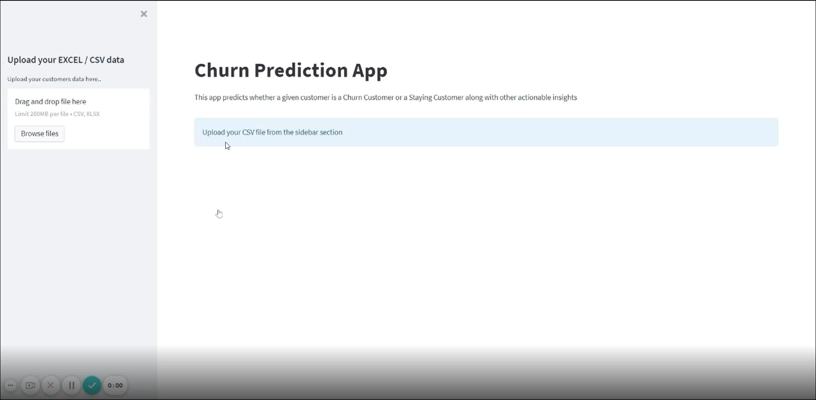
x
x
x
x
App Demo
Notes:
Add note to this slide

Slide 13

x
x
Q & A
GROUP D
x
x
Notes:
Add note to this slide

